Slide 1
Introduction into the EU AI Act
Patrick Qvick

Slide 2
WHY?
Why is EU implementing new legislation?
WHAT?
What does EU AI Act contain in brief?
HOW?
How is the Act Enforced?
WHEN?
Where are we on the path to implement the act?
Key take aways
What to do next?

Slide 3
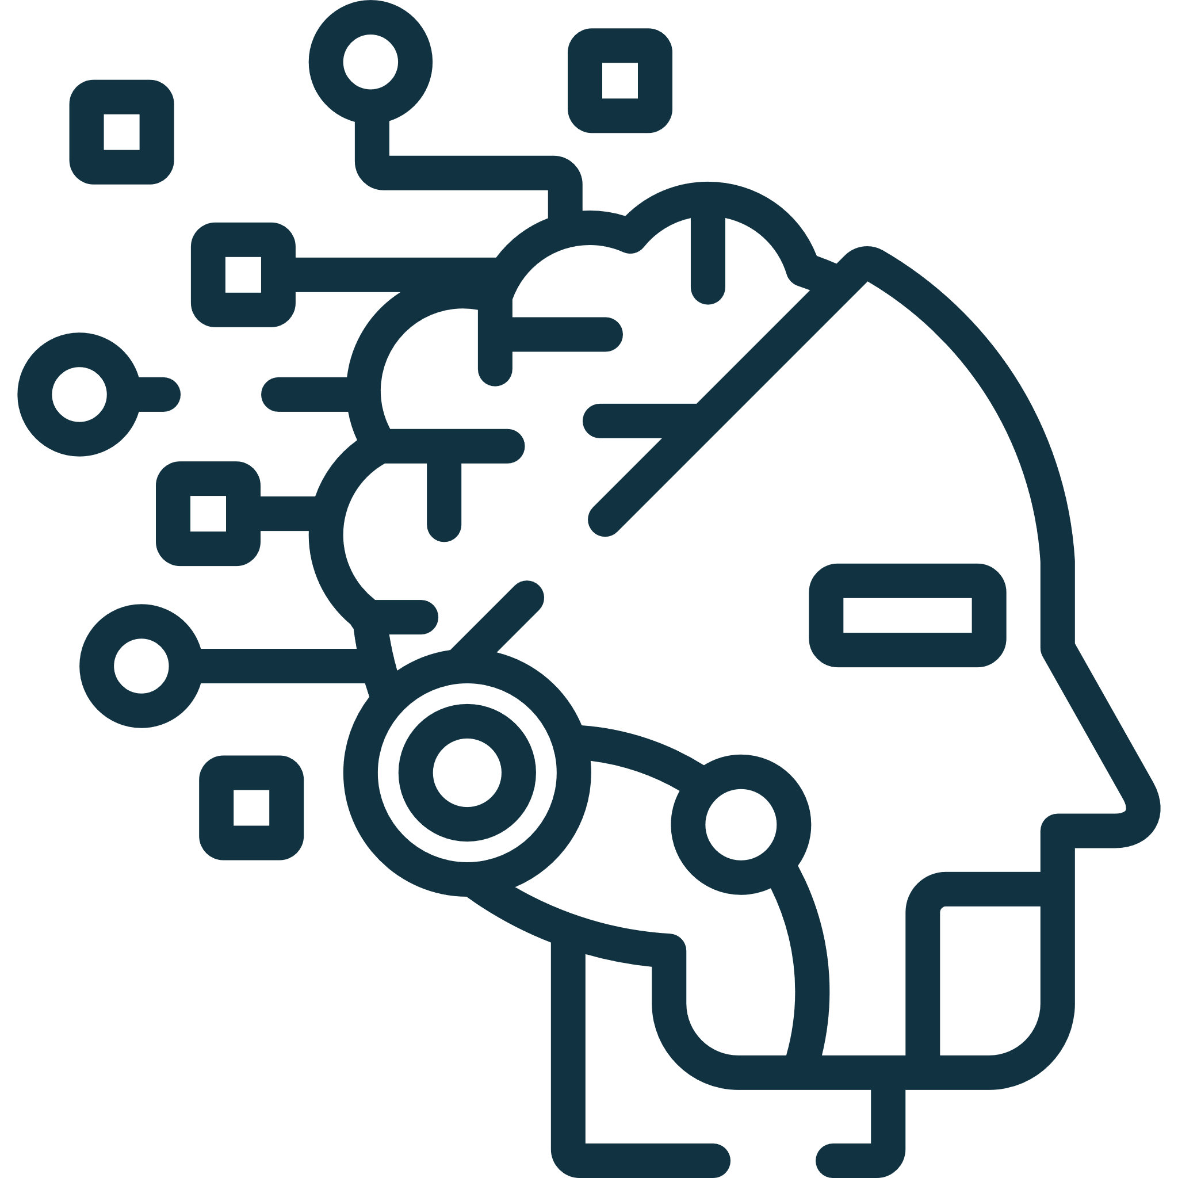



Why is EU implementing new legislation?
AI becoming more important
Legislation promoting safe AI that respects fundamental rights
Brings new risks or negative consequences
Harmonised rules for developing and placing AI in use at EU
Notes:
As AI continues to gain momentum and play a significant role in our lives, it does not only create great opportunities and solutions for us to use, but it also creates new types of risks and possible negative consequences.
In order to ensure AI can bring us the great benefits it promises while limiting the risks related to it, the European Union is:
is calling for the promotion of safe AI that respects fundamental rights. This is a critical component of the act and reflects the EU's commitment to ensuring that AI is developed and used in a responsible and ethical manner.
Also, the Artificial Intelligence Act calls for harmonized rules for developing and placing AI in use within the EU. This will provide a comprehensive framework for the development and use of AI, setting standards for transparency, accountability, etc.. By creating these harmonized rules, the EU is taking a proactive approach to ensuring that AI is not only safe and ethical, but also competitive.

Slide 4
What does EU AI Act contain in brief? – Two key concepts
Definition of AI
Risk Based Approach
Notes:
Definition of AI: The EU AI Act defines AI as "software that is able to perform tasks that would normally require human intelligence, such as understanding natural language, recognizing images, or making decisions." This definition is broad and includes a wide range of AI applications, from simple chatbots to more complex systems like self-driving cars.
One topic of debate has been which systems will fall under the definition of “AI systems.” The Council is in favor of a narrower definition, which may be further specified by the Commission so as not to capture all types of “traditional” software. The proposed definition includes systems with an “element of autonomy.” However, this component of the definition is not qualified or quantified and leaves room for interpretation and legal uncertainty.
However, we will see where this goes with the final version.
Risk-based approach: The EU AI Act takes a risk-based approach to regulating AI, meaning that the level of regulation will depend on the level of risk posed by the AI system in question. High-risk AI systems, such as those used in critical infrastructure or healthcare, will be subject to more stringent regulations than low-risk systems, such as those used in marketing or customer service.
GDPR similarities and differences…

Slide 5
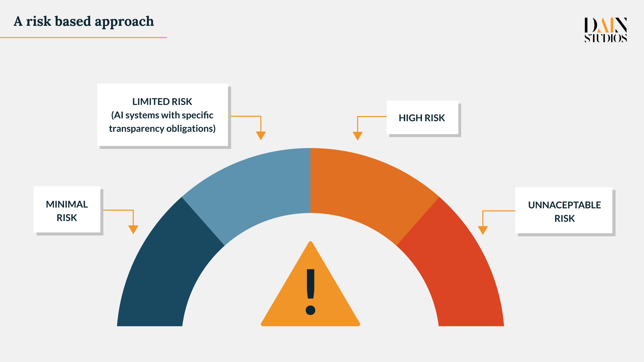
EU AI Act Risk Categories
Notes:
Starting from the left-hand side, we have first:
Minimal risk, that include AI applications such as spam filters or AI-enabled video games. There are no specific requirements for these, however Commission proposes that these are mainly regulated by voluntary codes of conduct.
Then we have limited risk, that include: Chatbots, deep fakes, emotion recognition systems to name a few. These are objected to transparency requirements.
High risk AI Applications, which include critical infrastructure, Biometric ID systems, education and vocational training (like automated scoring of exams), Employment, workers management and access to self-employment, Essential private and public services (like automated welfare systems, evaluate the creditworthiness ), Law enforcement systems that may interfere with people’s fundamental rights, Migration, asylum and border control management and Administration of justice and democratic processes. What must be noted here is that the list of high risk AI systems outlined in appendix of the legal text there is also a mention in Article 7 that states: “AI systems pose a risk of harm to the health and safety, or a risk of adverse impact on fundamental rights” which then broadens the scope
Finally Unacceptable risk, which include Subliminal techniques, Manipulation (‘an AI system that exploits any vulnerabilities of a specific group of persons due to their age, physical or mental disability, in order to materially distort the behaviour of a person pertaining to that group in a manner likely to cause… physical or psychological harm’), Social scoring (“a social behaviour credit system created or used by a public authority to evaluate or classify the ‘trustworthiness’ of natural persons; ”) and Biometrics: ‘“real-time” remote biometric identification systems’ in ‘publicly accessible spaces’ used by law enforcement. So this are not accepted, with some exceptions.
So what kind of requirements does the EU AI Act set for high risk systems…

Slide 6
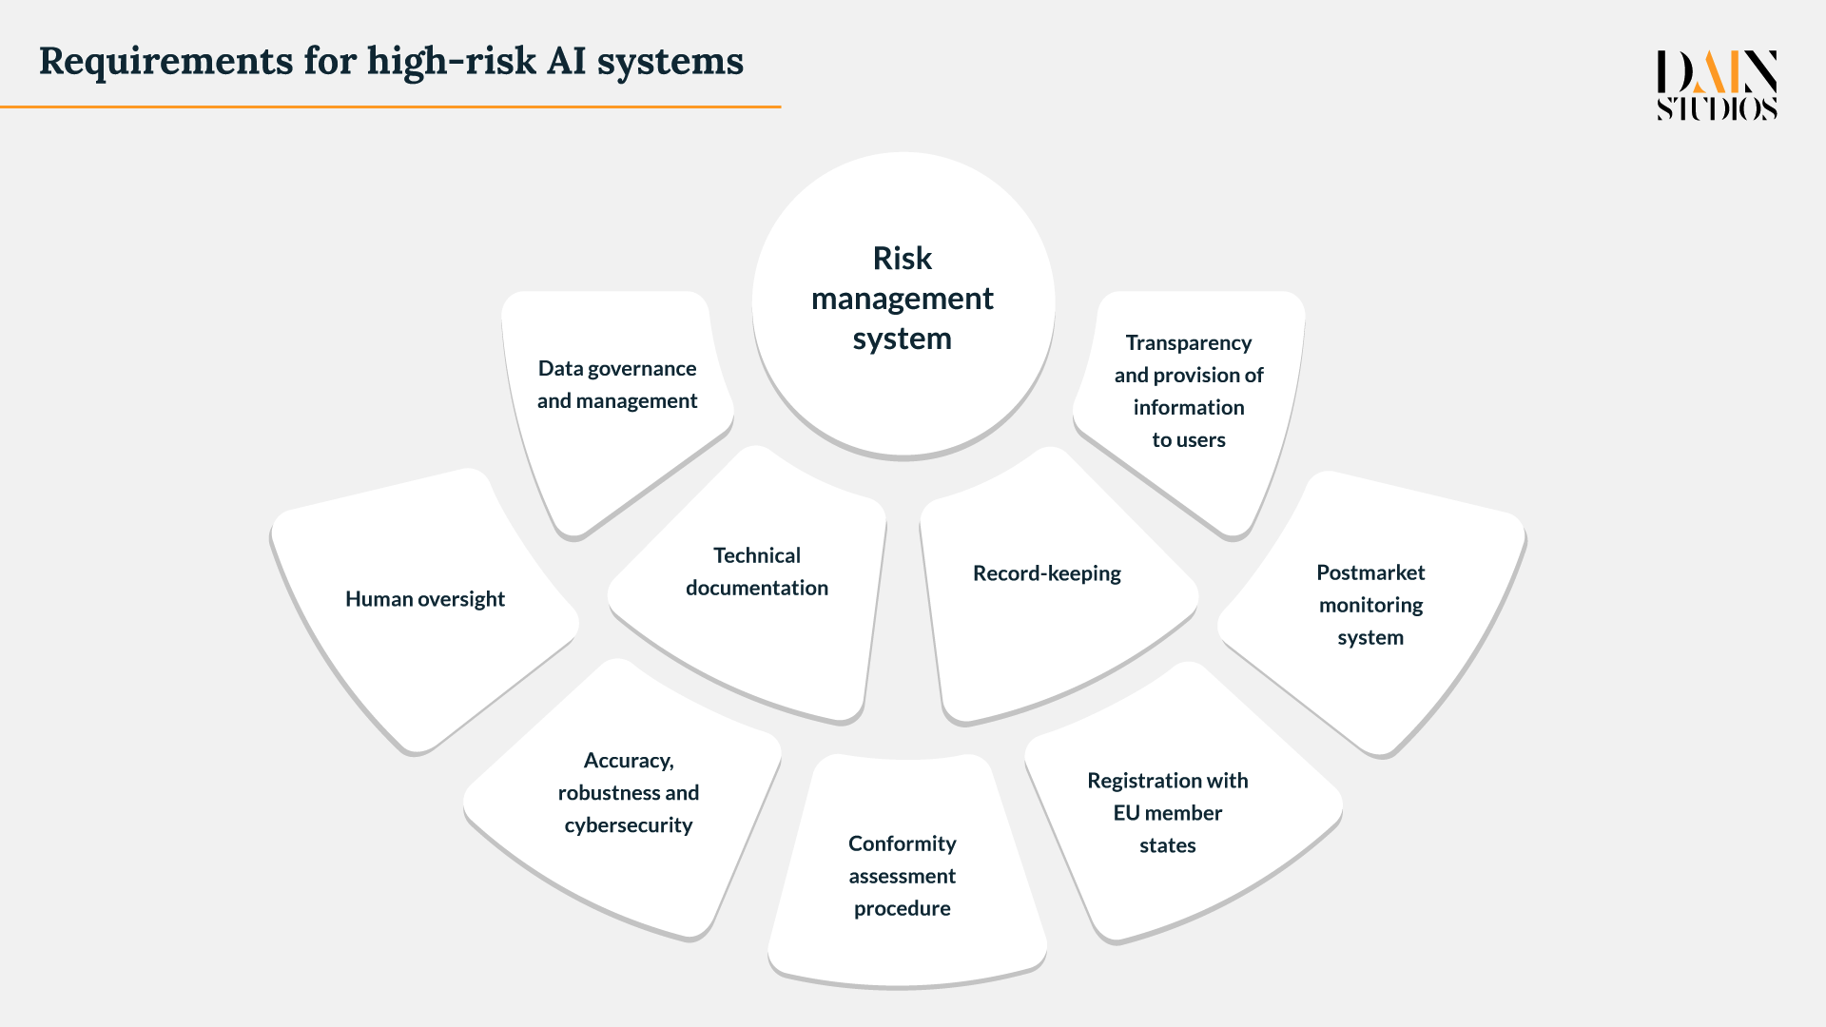
Notes:
The EU AI Act sets stringent requirements for high-risk AI systems, including mandatory impact assessments, human oversight, and transparency requirements. These requirements are designed to ensure that high-risk AI systems are developed and used in a responsible, trustworthy and ethical manner.
Let's dive a bit deeper into some of these requirements for high-risk AI systems outlined in the EU AI Act.
First, the act requires the implementation of Risk Management Systems. These systems are designed to identify, assess, and manage the risks associated with AI. This includes the potential impact on human rights and freedoms, public safety, and the environment. Companies and individuals that use high-risk AI systems are required to implement these systems and to continuously monitor and assess the risks associated with their AI systems.
Second, the act places a strong emphasis on Data Governance and Management. This includes requirements for data protection, data quality, and data security. Companies and individuals are required to ensure that the data used to train and operate AI systems is accurate, secure, and protected. This is essential to ensuring that AI systems are reliable and trustworthy.
Third, the EU AI Act places a strong emphasis on transparency. Companies and individuals are required to provide information about their AI systems, including how they work, what data is used, and the potential impact on human rights and freedoms. This information must be made available to the public and to regulators, so that the public can make informed decisions about the use of AI.
Finally, the act requires human oversight for high-risk AI systems. This means that AI systems must be designed in a way that allows for human intervention and that decisions made by AI systems can be reviewed and evaluated by humans. This is essential to ensuring that AI systems are used in a responsible and ethical manner and that the potential impact on human rights and freedoms is minimized. People who are familiar with GDPR article 22 Automated individual decision-making, including profiling, might find similarities in this requirement as well as the transparency requirement.

Slide 7
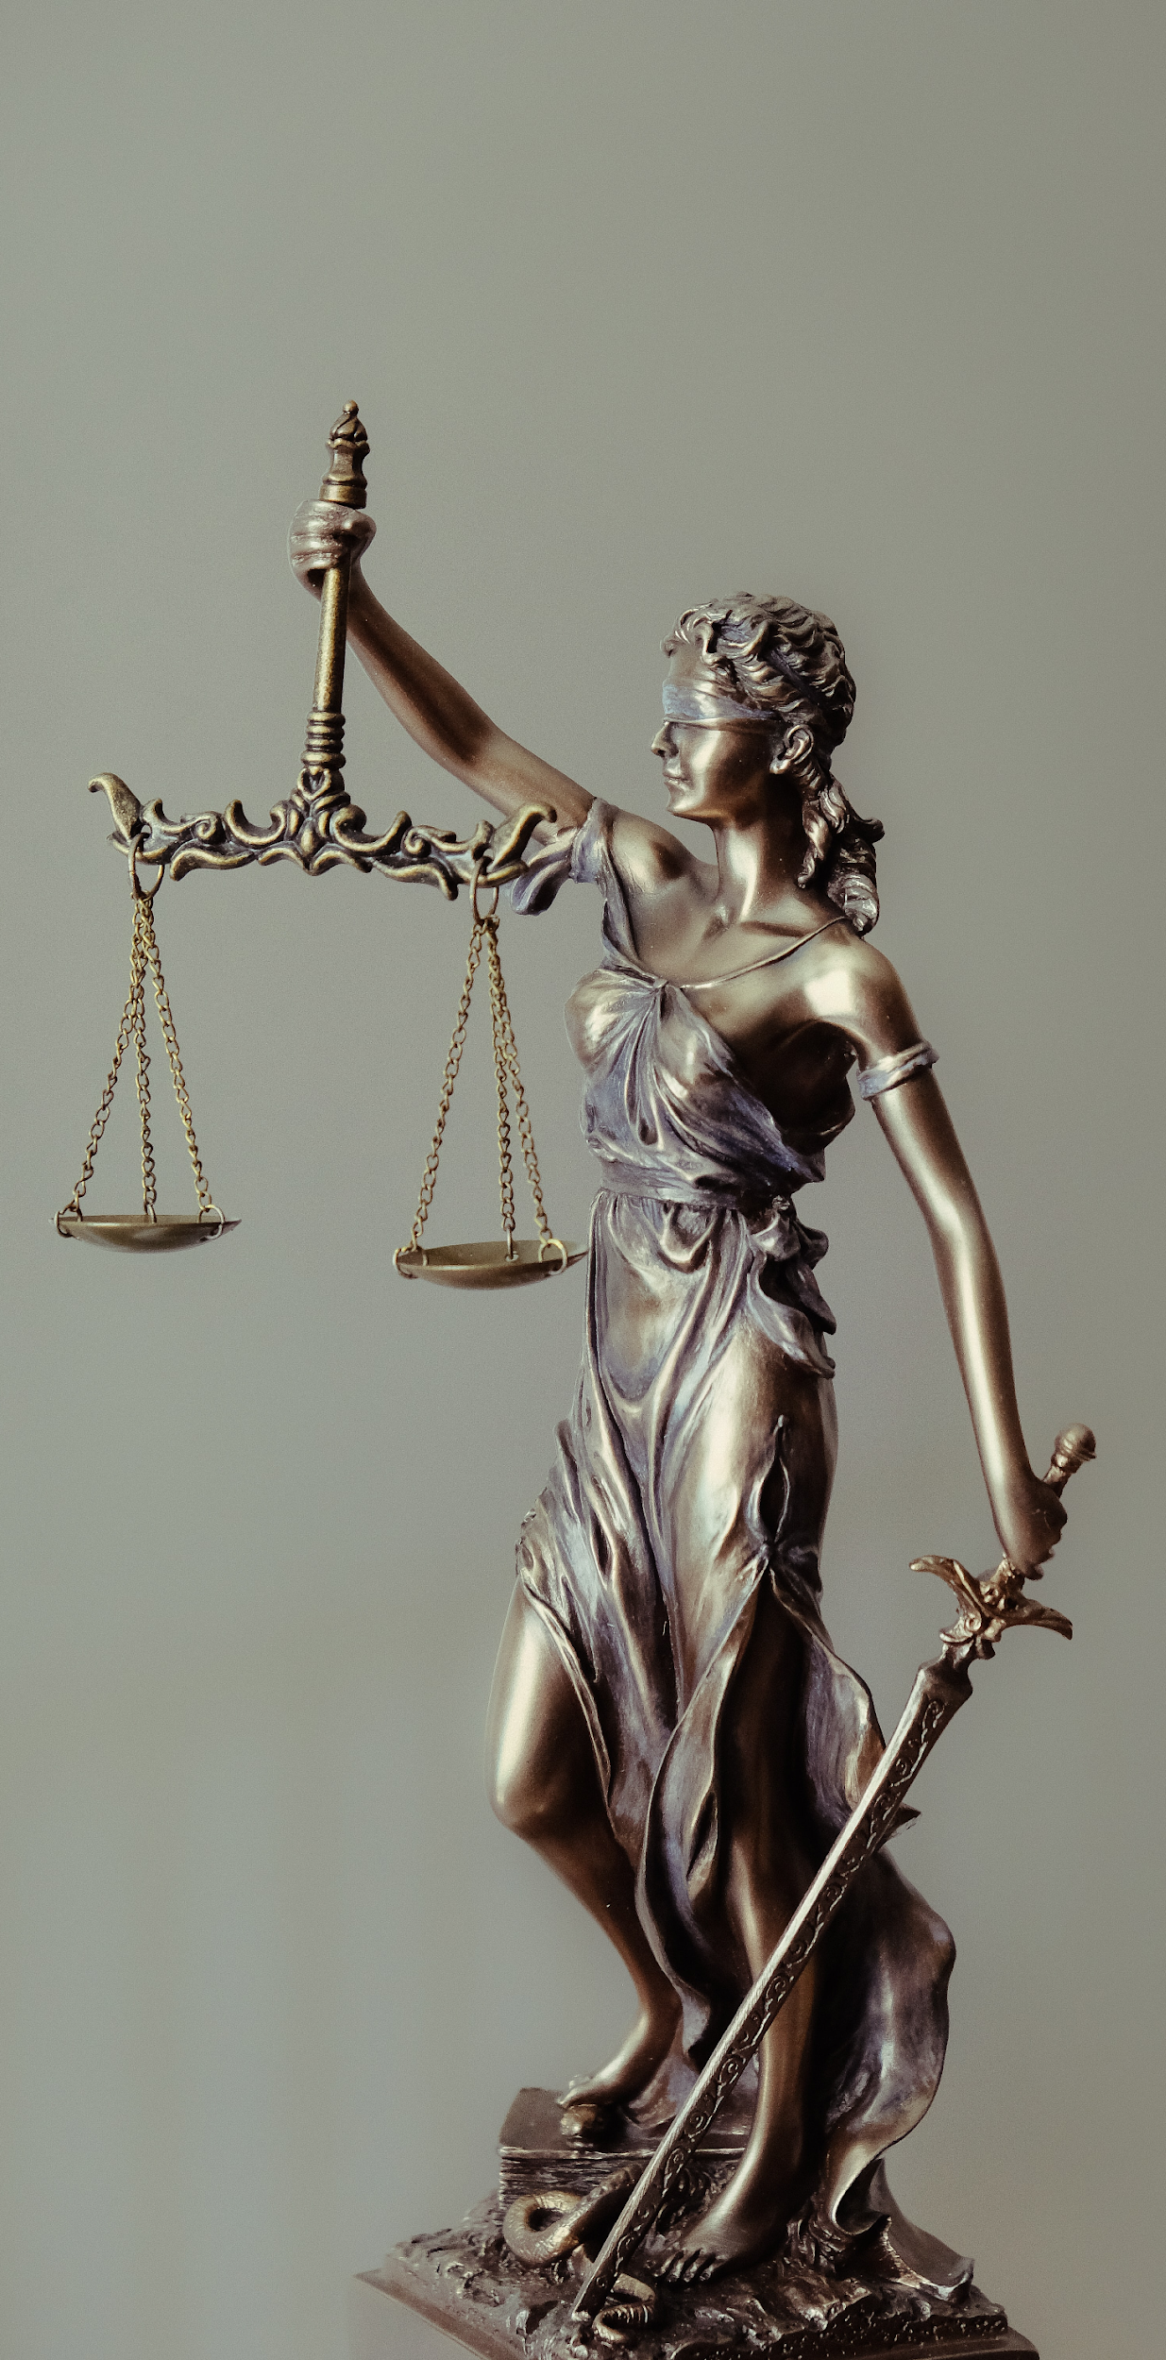
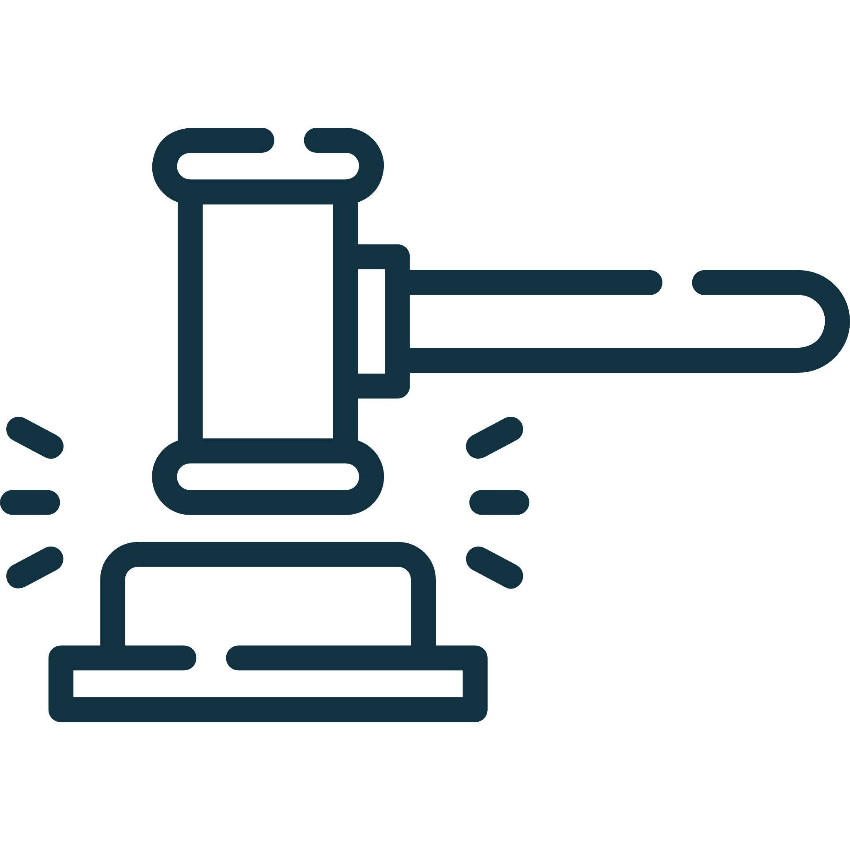
How is the Act enforced?
European Commission, national supervisory authorities and the courts
Penalties up to 6% total worldwide turnover or 30 million
Notes:
As with any similar legislation the enforcement is done by establishing national supervisory authorities in member states, and in some cases the enforcement takes place in court.
One of the key provisions of the act is the imposition of penalties for non-compliance with its rules. The penalties for non-compliance with the EU AI Act are similar to those established under the General Data Protection Regulation (GDPR). Both laws establish fines for non-compliance, with the EU AI Act proposing penalties of up to 6% of a company's global annual revenue or €30 million, whichever is higher. This is higher than the maximum fines provided for under the GDPR (4% or 20 million).

Slide 8

How is the Act enforced?
Increased awareness
European Commission, national supervisory authorities and the courts
Penalties up to 6% total worldwide turnover or 30 million
Notes:
In addition to the risk of non-compliance and penalties, there is also the risk associated with increased public awareness and scrutiny of the use of artificial intelligence. This increased awareness can lead to increased media attention and a heightened sense of concern among individuals, which in turn can increase certain risks, such as reputational risk.
Reputational risk refers to the risk that an organization's reputation may be damaged by negative publicity, public perception, or loss of trust. In the context of AI, this could include instances where AI systems are perceived as biased, discriminatory, or lacking in transparency. This could result in significant harm to an organization's reputation, especially if the public becomes aware of such issues through media coverage.
To mitigate reputational risk, it is important for organizations to be transparent about their use of AI, and to ensure that their AI systems are designed and operated in a manner that respects individuals' rights and values. This can include developing and implementing ethical AI principles, conducting impact assessments to identify potential risks, and engaging with stakeholders, such as customers, employees, and regulators, to understand their concerns and address any issues that may arise.
By taking a proactive approach to managing reputational risk, organizations can help to protect their brand and reputation, and maintain the trust of their stakeholders in the use of artificial intelligence.

Slide 9
Where are we on the path to implement the act?
We are here!
April 2021
Dec 2022
Est. March 2023
Est. By end of 2023
The European Commission released the proposed Regulation on Artificial Intelligence (the EU AI Act)
Council approved a compromised version
Parliament vote for AI Act
Adopting of AI Act
Transitional period ends….
Notes:
The timeline of the EU AI Act is still uncertain, as the act is currently in the proposal stage and has not yet been adopted. The process of adopting new legislation in the European Union involves several steps, some of which are present in this slide here.
After the act is adopted, it will likely take some years to become fully effective. This timeline can vary depending on the specifics of the legislation and the length of time required for implementation. With GDPR the timeline was 2 years and based on my understanding something similar would be followed here.
It is important to note that the timeline for the EU AI Act is subject to change and may be influenced by a variety of factors, including the outcome of negotiations and discussions, the pace of technological development, and the priorities of the European Union.

Slide 10


Take-Aways
Start Early
Take the steps:
Understand requirements
Assess current state
Create a plan
Implement and change
Think outside of the legislation
Notes:
Start thinking about ethics of AI already now, if you are creating or using AI somewhere.
Consider taking steps: understand requirements, assess the current state, create a plan going forward, Implement and change. In order to understand the requirements it might be beneficial to use specific experts that are aware of the new requirements set by the EU AI Act. What I have realised when talking about this as well as GDPR over the years is that, quite often invalid understanding of specific things are created, which can become memes in the organisations. Meaning that an understanding of that something cannot be done because of legislations is adopted by an organisation, which might not be fully true and harms the organisations business compared to its competitors
And my last point… Organizations should think about AI ethics not only because of the potential legal and regulatory implications, but also because of the wider ethical and societal considerations involved in the development and use of AI.
One reason is that AI has the potential to impact people's lives in significant ways, and it is important for organizations to consider the ethical implications of the technologies they develop and use. This can include issues related to privacy, equality, fairness, and accountability. By considering these ethical considerations, organizations can ensure that their AI systems are developed and used in a responsible and sustainable manner, and that they have a positive impact on society.
Another reason is that organizations have a moral obligation to consider the ethical implications of AI. This is particularly important given the rapid pace of technological development, and the increasing prevalence of AI in society. By taking a responsible and ethical approach to AI, organizations can help to build trust in the technology and ensure that it is used in a way that benefits society as a whole.
In addition, there are also business reasons for organizations to consider AI ethics. For example, a reputation for ethical and responsible use of AI can help organizations to build customer trust and loyalty, and can also enhance their brand and reputation. This can in turn lead to increased customer loyalty and better business outcomes, such as improved sales and market share.
In conclusion, organizations should think about AI ethics not only to comply with legal and regulatory requirements, but also to ensure that they are operating in an ethical and responsible manner, and to reap the potential business benefits of doing so.

Slide 11
Patrick Qvick
https://www.linkedin.com/in/patrickqvick/

