Slide 1
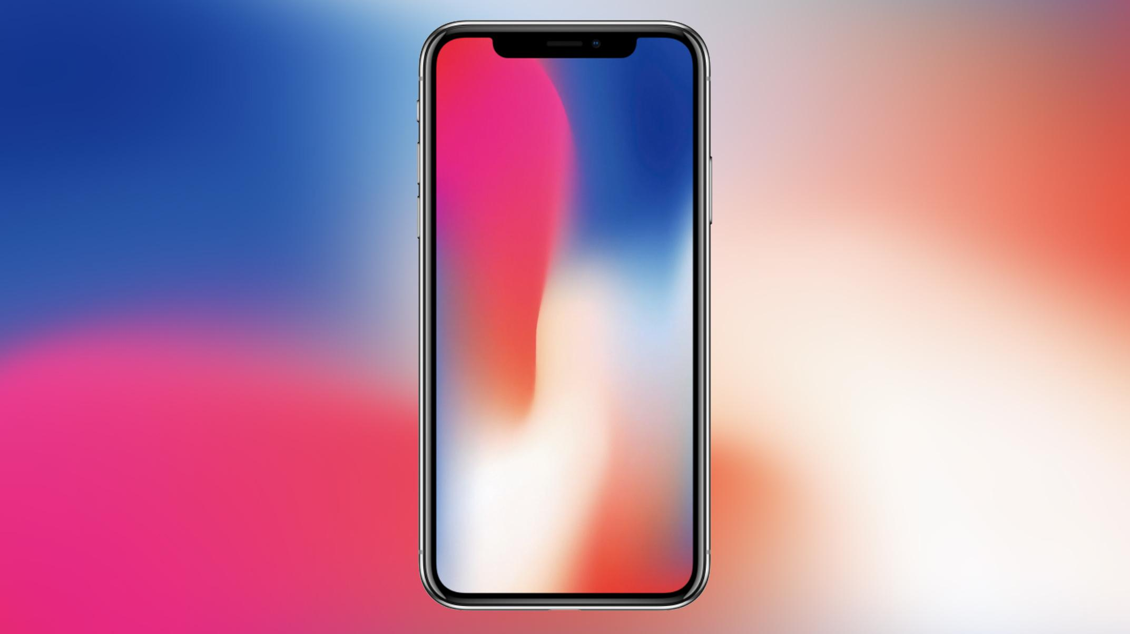

The AI tooling journey
Patrick Naumann - Software Developer/AI Engineer - Appsfactory GmbH

Slide 2
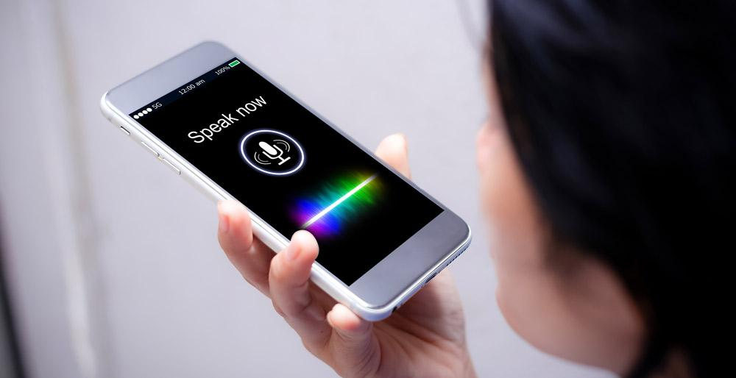
CONTENT
01
HOW THE JOURNEY STARTED
02
WHEN EXPECTATIONS WERE NOT MET
03
LESSONS LEARNED
04
APPSFACTORY

Slide 3










































CUSTOMERS

Slide 4

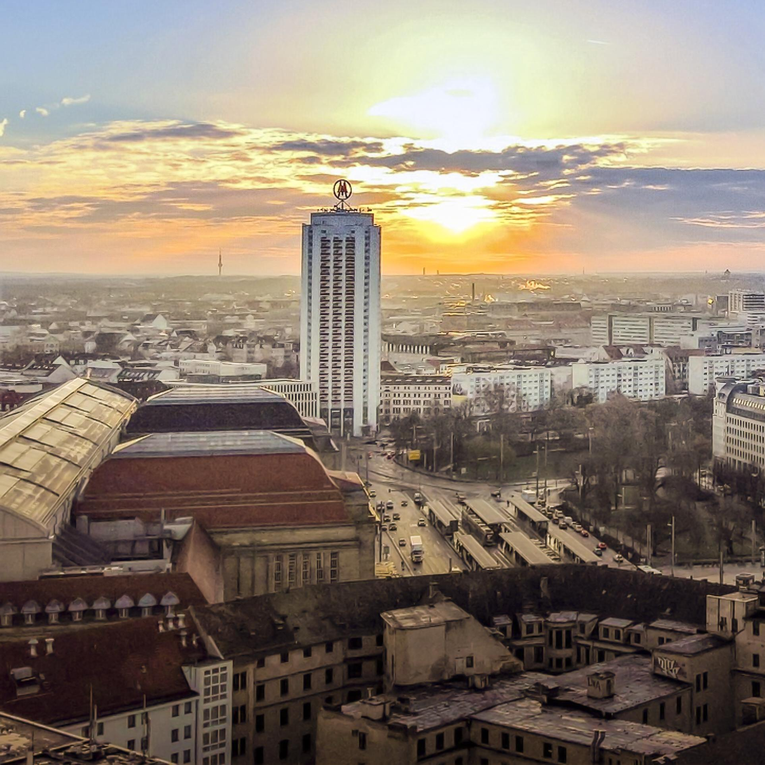

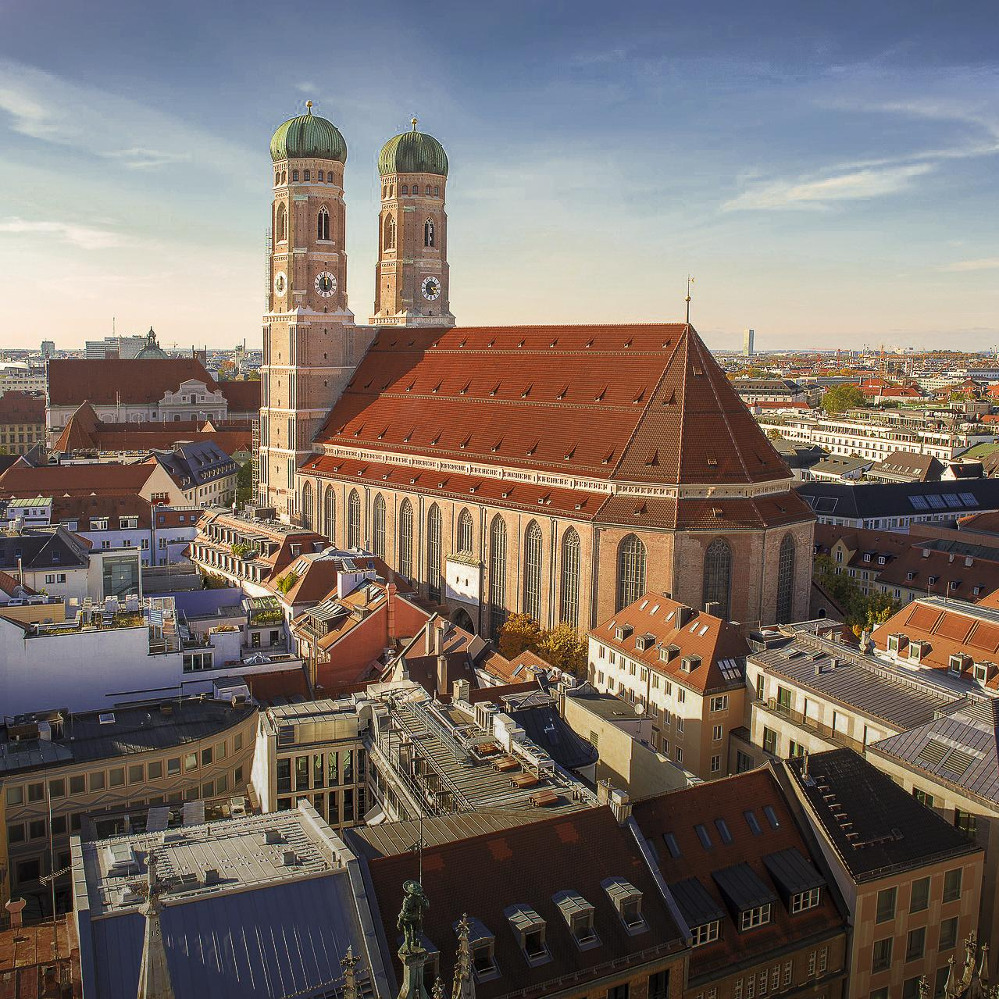
OFFICES
HAMBURG
LEIPZIG
ERFURT
MÜNCHEN
Consulting, UX & Design,
Frontend Development, Project Management
Consulting, UX & Design,
Front- and Backend Development, Project Management, Azure and AWS
Cloud Services, Quality Assurance
Administration
Consulting, UX & Design,
Frontend Development, Project Management
Consulting, UX & Design,
Frontend Development, Project Management

Slide 5
HOW THE JOURNEY STARTED
CUSTOMER REQUEST
MATCHBOX
RECOMMENDER
PROTOTYPES
EVALUATION
Recommendations
Tracking data
Existing endpoints
Content-based filtering
Collaborative filtering
Feedback models
Different feature sets
Different scorings for user feedback
User comparison
Objective evaluation

Slide 6
WHEN EXPECTATIONS WERE NOT MET
RESULTS
INVESTIGATION
MICROSOFT TECHNICAL SUPPORT
Few result sets
Mostly same items
Different order
Documentation
Settings
Examples
Data preparation
Statistics
Phone calls
General help
No debugging

Slide 7
WHEN EXPECTATIONS WERE NOT MET
CUSTOM IMPLEMENTATION
SIMILAR RESULTS
Insights
Same data
Embeddings
Matrix factorization /
Dense layers
Simple Model
Explainability
Debuggable
Visualization
Clustering
Dominant Categories

Slide 8
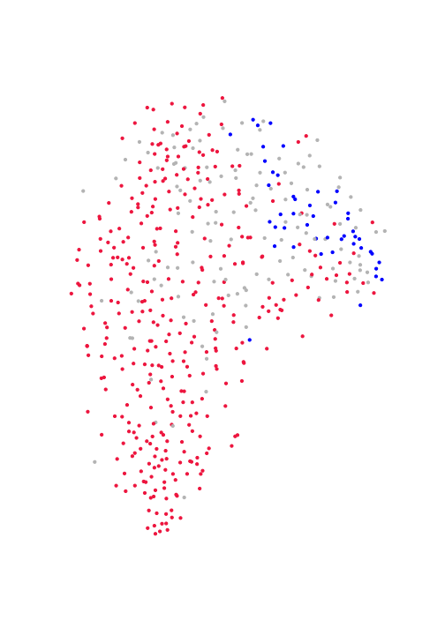
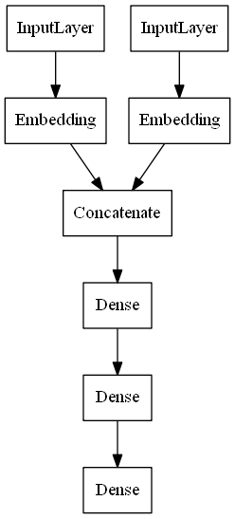
WHEN EXPECTATIONS WERE NOT MET

Slide 9
WHAT FOLLOWED AFTERWARDS
01
02
MODEL IMPROVEMENT
DATA IMPROVEMENT
Balancing
Complexity
Training methods
Additional features
Unknown items

Slide 10
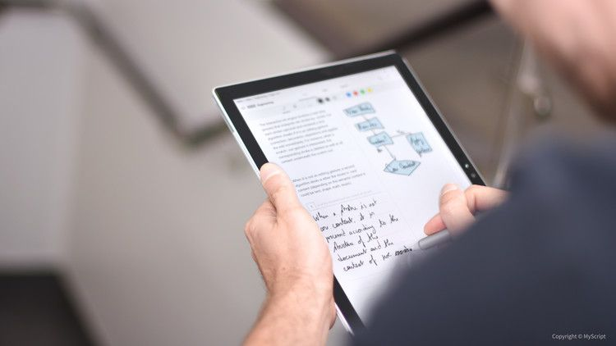
LESSONS LEARNED
01
KNOW YOUR REQUIREMENTS
02
KNOW YOUR DATA
03
KNOW YOUR TOOLS

Slide 11
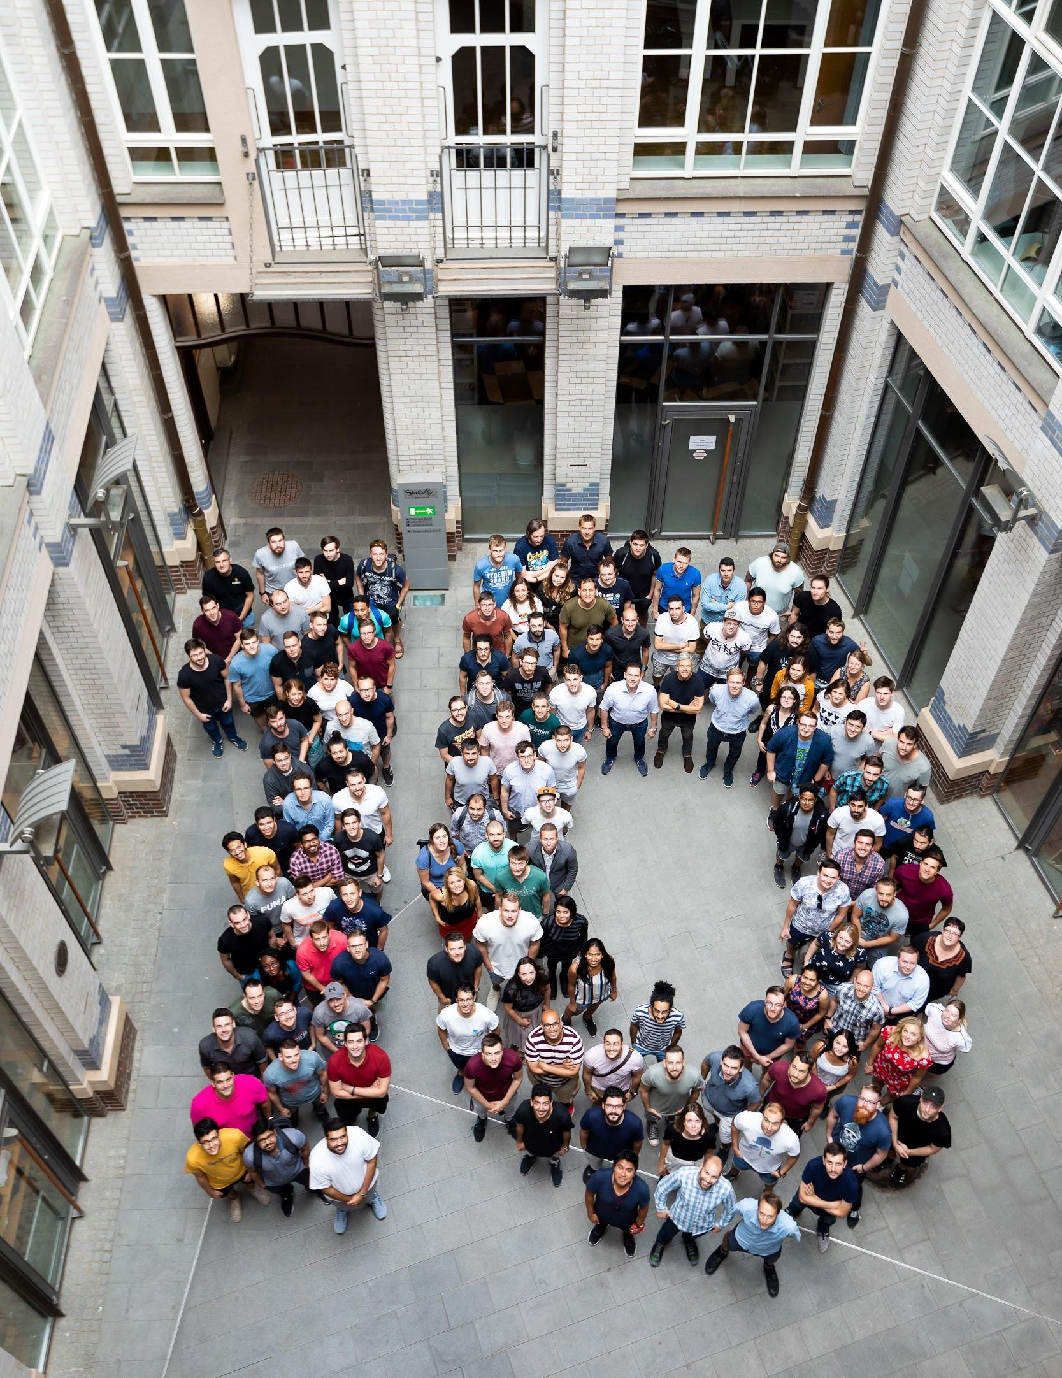
ABOUT APPSFACTORY
Agency
Mobile, Backend, VR/AR, AI
600+ PROJECTS
B2B and B2C
210+ EMPLOYEES
+1-2 new employees per month
80+ CLIENTS
Consumer Goods, Finance, Health, Media, Telecom, Transportation, Travel

Slide 12

WE ARE HIRING
WWW.APPSFACTORY.DE
ADDRESS
EMAIL
TELEPHONE
Nikolaistr. 28-32
04109 Leipzig
info@appsfactory.de
+49 34135592050

