Slide 1
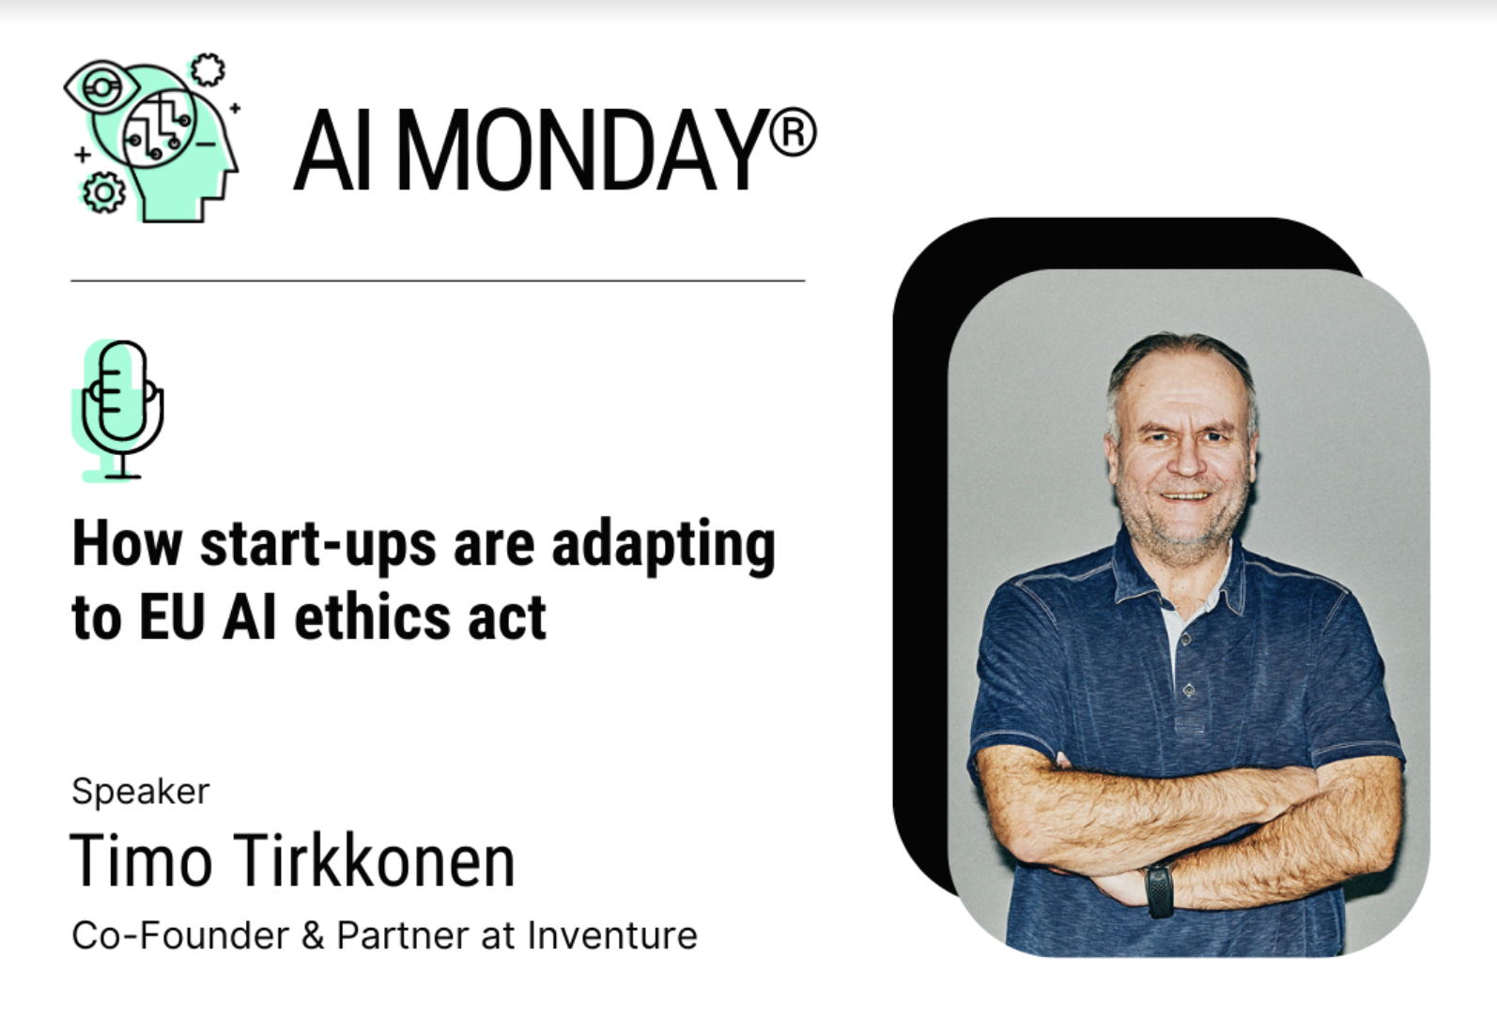
#AIMonday

Slide 2
How start-ups are adapting to EU AI ethics act
00
Timo Tirkkonen, Inventure
13/02/2023

Slide 3


AI Act from a start-up point of view
Oh no, yet another regulation or directive
Does it apply to us, we are small
Work and cost?
Does anybody understand it?
Will it pass, poorly done, definition etc..
Smart ones turns AI Act to their advantage and to an USP

Slide 4
AI Act from a start-up point of view
It is becoming increasingly clear how AI is going to be regulated in the near future and how this could change the ways AI is developed and deployed.
The AI Act puts a premium on trustworthy AI.
A great way to achieve trustworthiness is by transitioning to explainable and transparent approaches to AI.
Going forward, such AI systems should therefore increasingly be incorporated into the business and marketing strategies of providers and users of AI.
Adopting this kind of technology is a way for businesses and organizations to future-proof themselves.

Slide 5

The definition
The central definition for the Act, that of AI is overly vague.
It has the potential to include companies whose core tech was not considered AI but only ML at this point.

Slide 6

Awareness is still low
A 2020 research carried out by McKinsey highlights that only 48% of the companies working on AI reported recognizing the issues of regulatory-compliance risks, and only 28% reported actively working to address them (source).

Slide 7

Portfolio companies perspective
The act arises multiple questions, including:
How to assess your own tech to get in the right risk class?
How not to lose the competitive edge to companies headquartered in geographies that don’t require strict regulation?
How to change the business to not get overwhelmed with the cost of compliance?
CE marking->IP->Patents
Can we turn this to something positive?

Slide 8
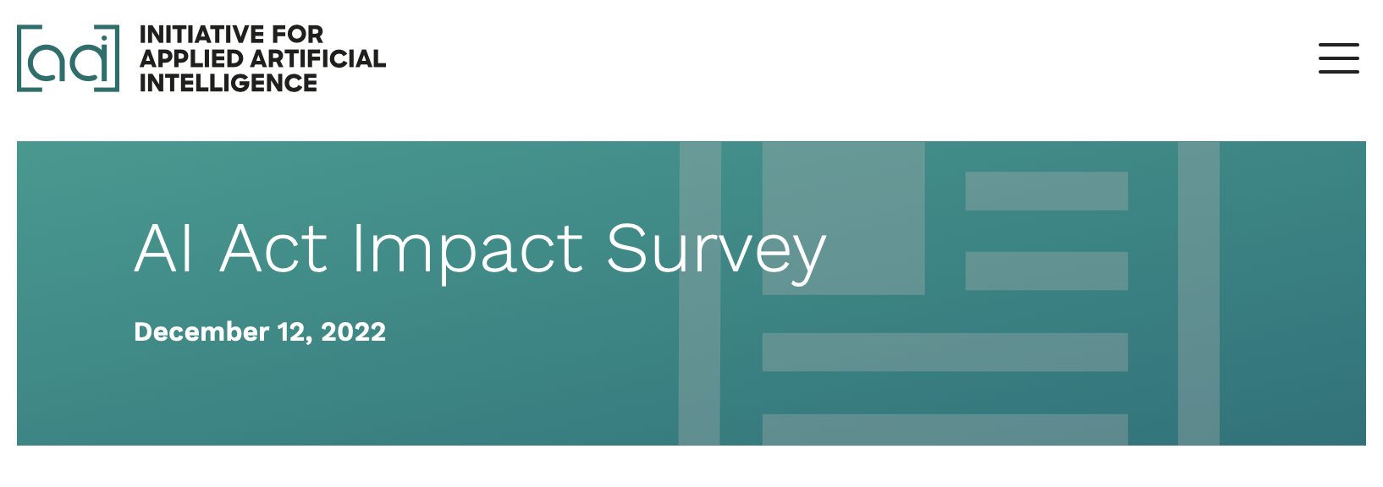
AI Act Impact Survey
113 AI Startups and other companies developing AI across Europe, including France, Sweden, Poland, Austria, the Netherlands and Germany
15 Venture Capital Firms

Slide 9

Main concerns
AI Impact Survey
33-50% of the AI systems may be classified as high-risk.
Initial assumption made in the Policy Impact Assessment by the EU commission was between 5 and 15%.

Slide 10

Main concerns
AI Impact Survey
50% of the participants believe that the AI Act will slow down AI Innovation in Europe.
16% consider stopping to develop AI or relocating outside of the EU.

Slide 11

Main concerns
AI Impact Survey
According to the survey, around 50% of the 100+ surveyed start-ups expect these costs to be €160-330K (as estimated by the EU), but 19% expect these costs to be even higher.

Slide 12

Investment perspective
AI Impact Survey
Regulation of High-Risk AI
The EU AI Act provides specific regulations for the use of high-risk AI, which could impact the investment potential of companies developing and deploying these technologies.
Most of the interviewed VCs from the survey consider shifting investments towards AI systems with a specific purpose in low-risk applications. 45% of the start-ups from the survey consider their solution a General Purpose AI.

Slide 13

Investment perspective
AI Impact Survey
Competition
The EU AI Act could impact the competitiveness of companies operating in the EU compared to companies operating in other regions that do not have similar regulations.
Most VCs interviewed for the survey think that the act will drastically reduce the competitiveness of European start-ups in the space.

Slide 14

Conclusions
We need clearer definitions and cost analysis
We need to make sure that the Act does not hinder innovation limit and our competitiveness in the world market.
Great start but still just the start

Slide 15


Slide 16
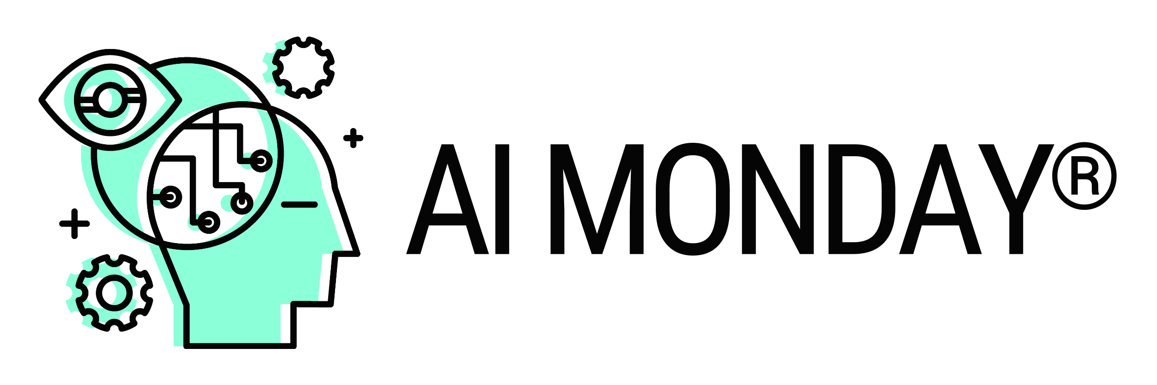

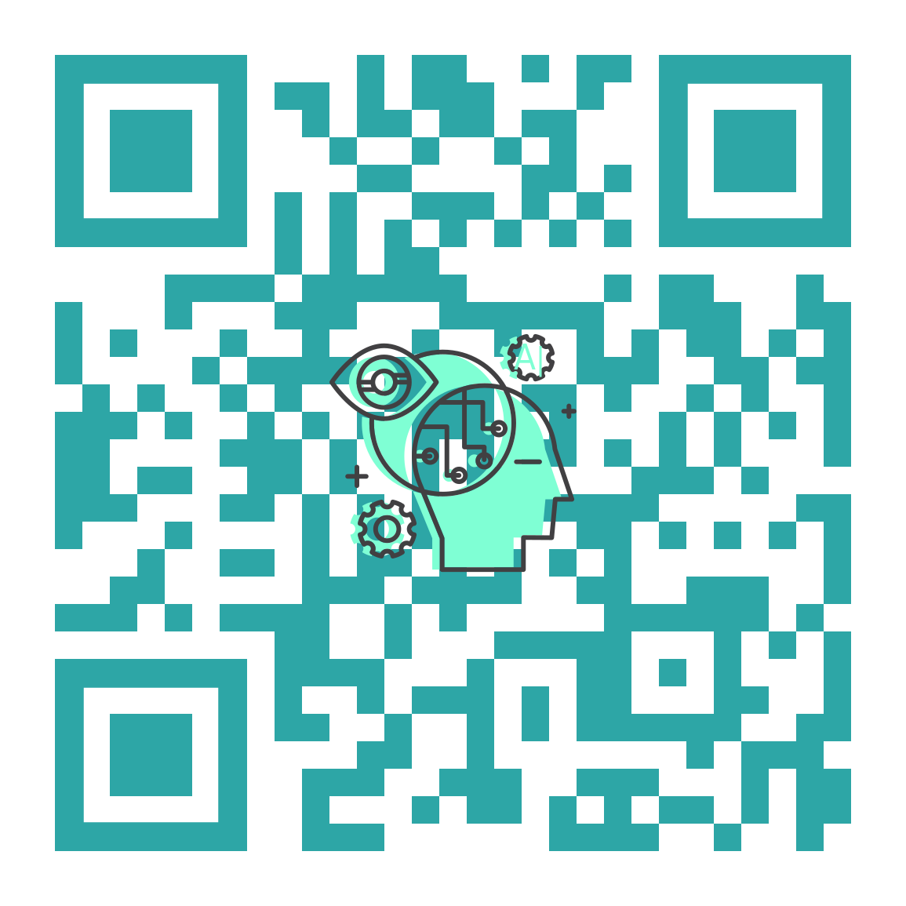
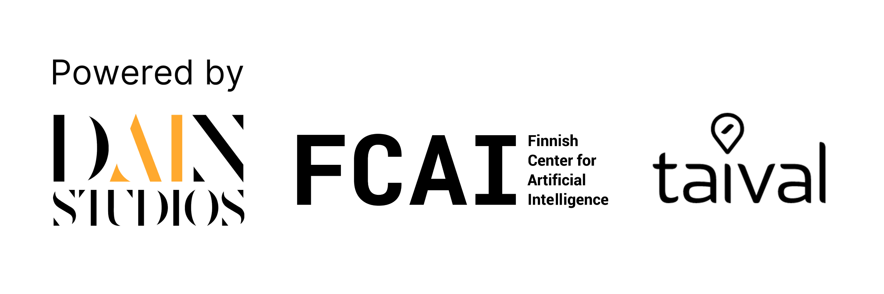
#AIMonday
Join The Community!
Website: ai-monday.de
Email: events@ai-monday.de
Notes:
NIINA: We will be holding more events this year. Contact us if you would like to collaborate and join our email newsletter list to stay up-to-date.

